Slide 1
Lecture 2 Divide & Conquer: Peak Finding
Spring 2024
Zhihua Jiang

Slide 2
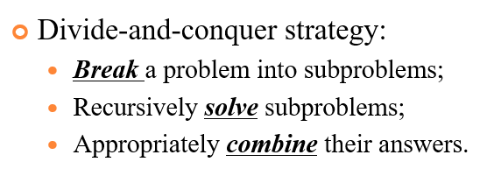

Slide 3
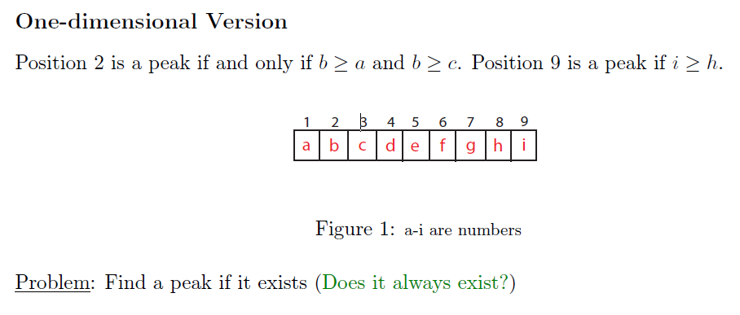
Peak Finder
PS: Given the above definition ≥, a peak always exists!
However, if only >, a peak does not always exist. E.g., y(x)=c.
Notes:
Not mean that there is only one peak. The problem is to find a peak.

Slide 4
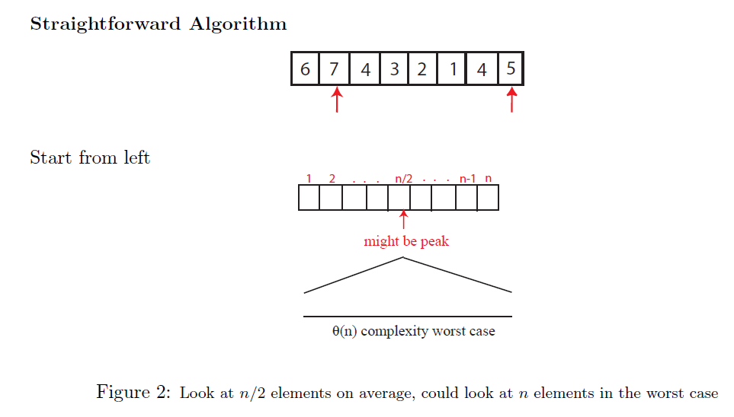
Peak Finder
Notes:
Average: (1+2+…+(n-1)+n)/n=(n*(n+1))/2n=(n+1)/2

Slide 5
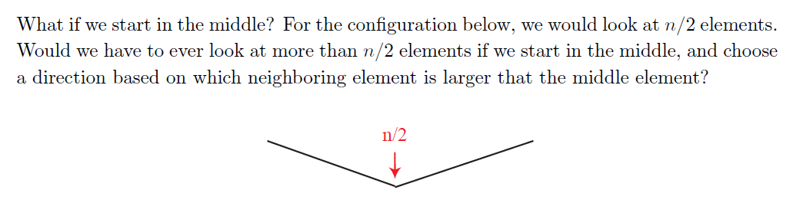
Peak Finder

Slide 6
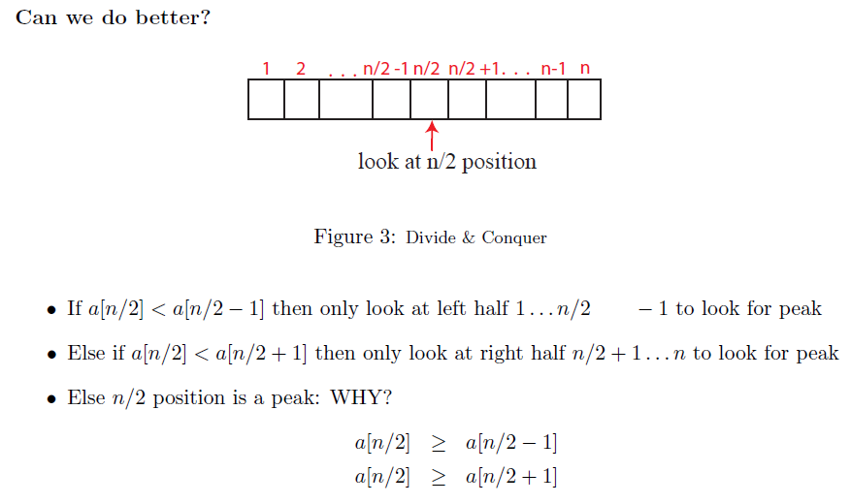
Peak Finder
n/2-1

Slide 7
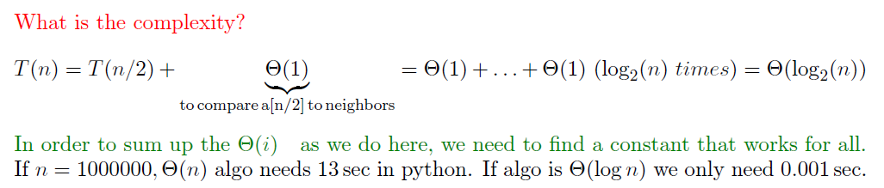
Peak Finder

Slide 8
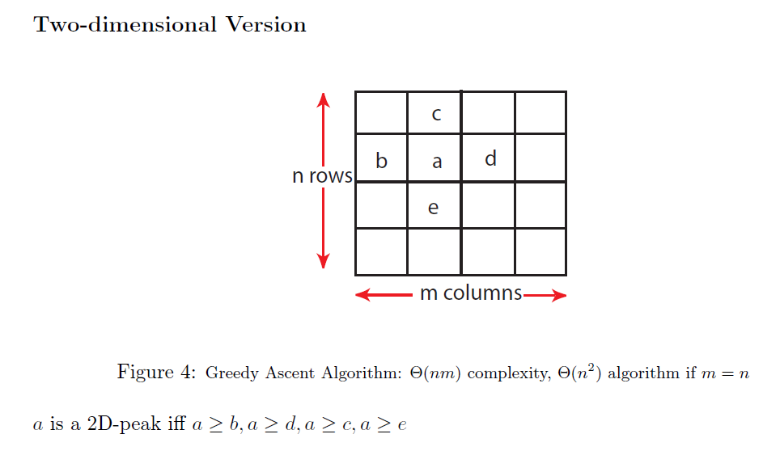
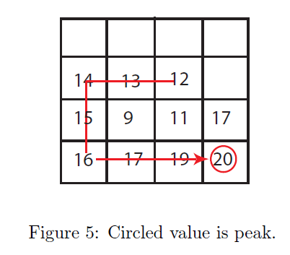
Peak Finder
Notes:
Greedy: follow the largest neighbor.

Slide 9
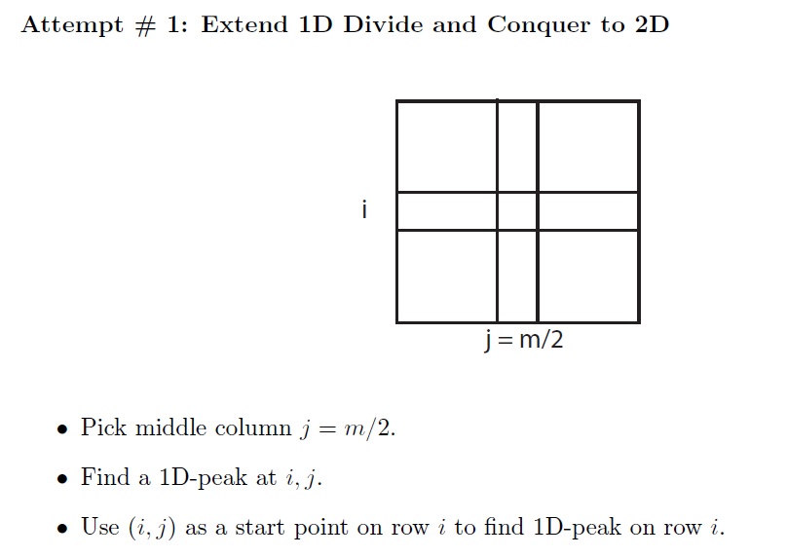
Peak Finder

Slide 10
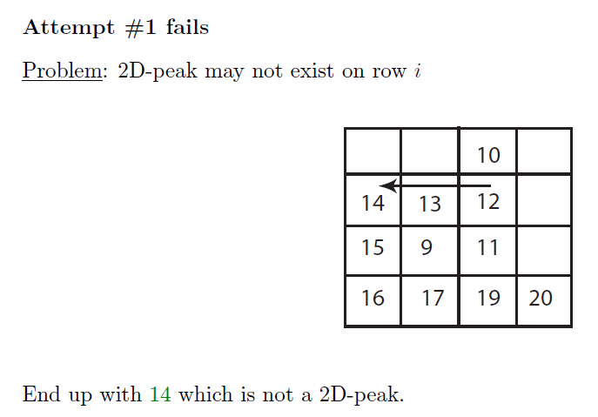
Peak Finder

Slide 11
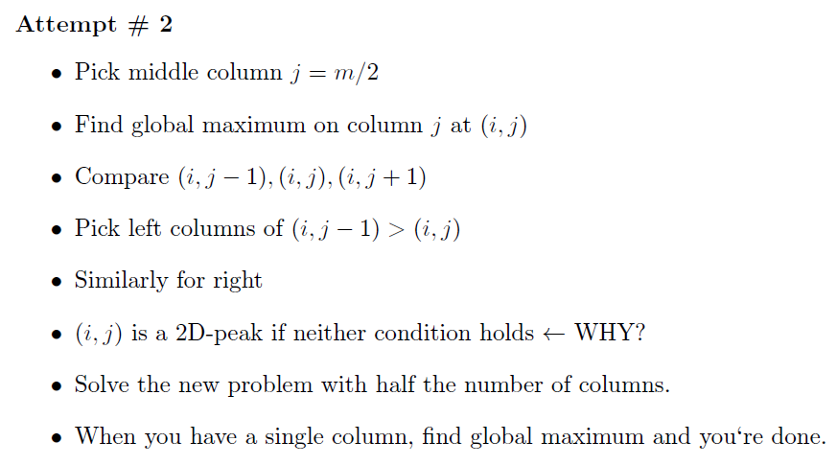
Peak Finder

Slide 12
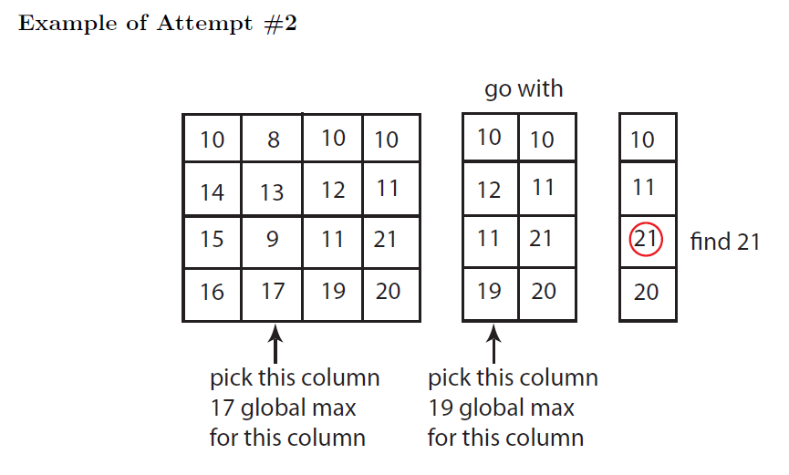
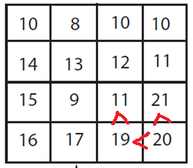
Peak Finder
why global max?
Notes:
21(max/peak)>20(larger neighbor of 19)>19(max)>11(neighbor of 21)

Slide 13
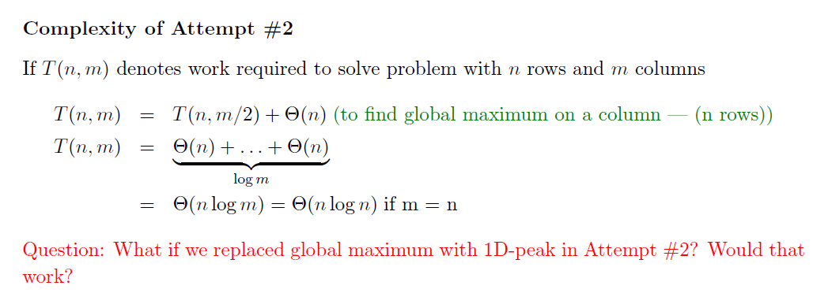
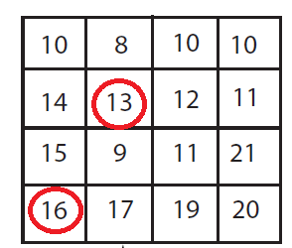
Peak Finder
Notes:
if m>>n, then m/2;
if n>>m, then n/2;
anyway, O(min{m,n}log(max{m,n}))

Slide 14
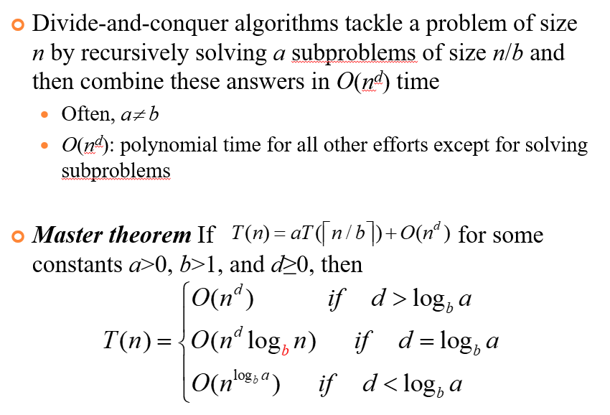

Slide 15
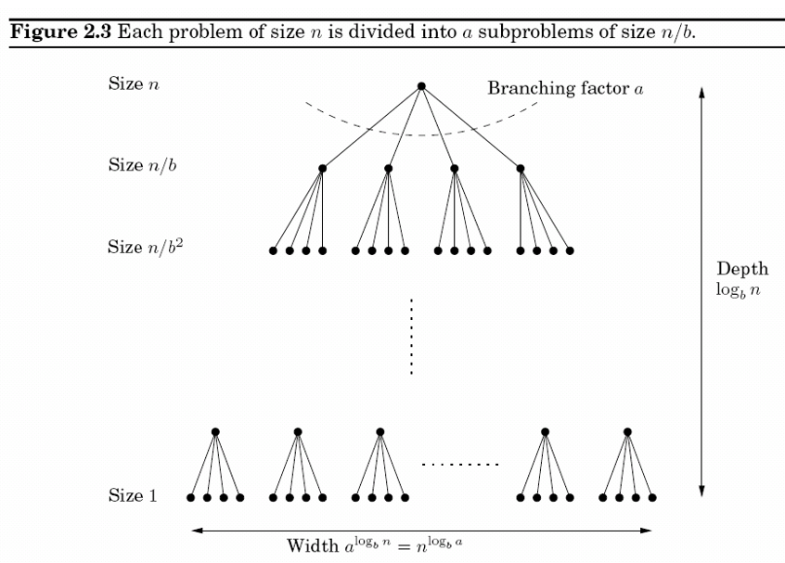

Slide 16
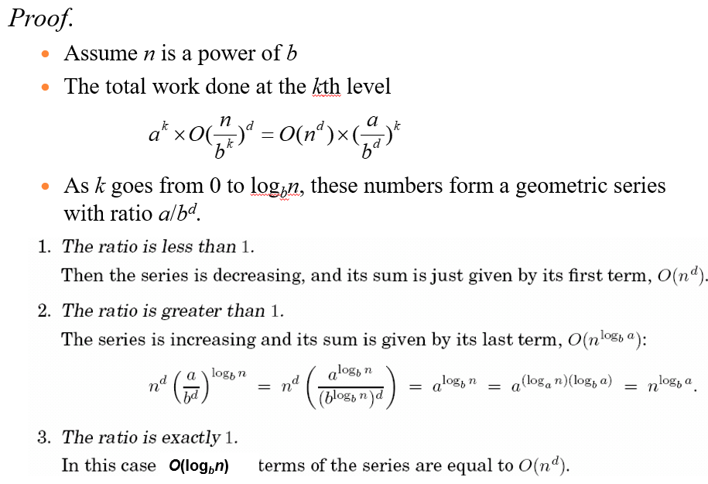

Slide 17
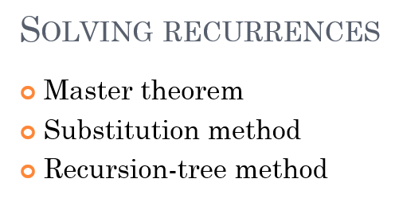

Slide 18
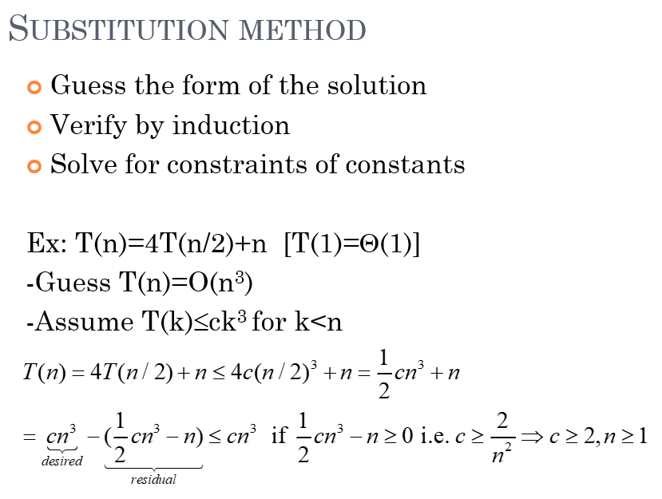

Slide 19
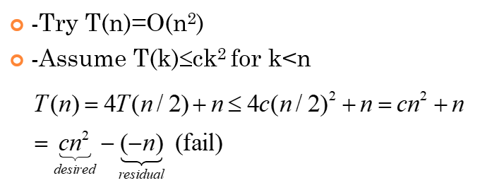
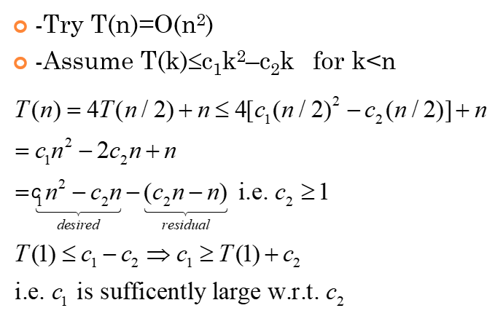

Slide 20
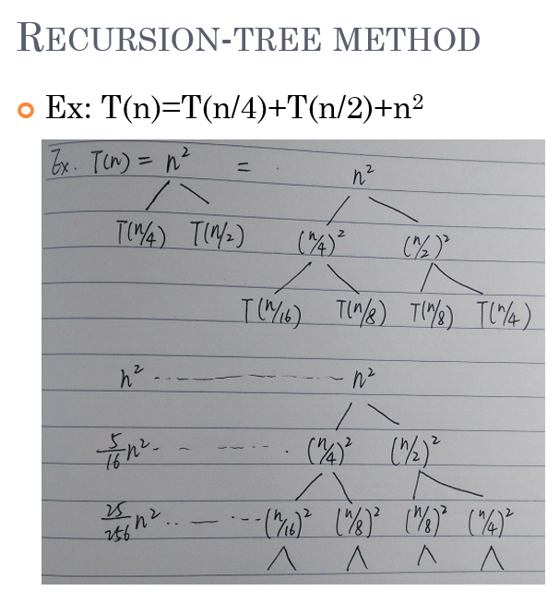
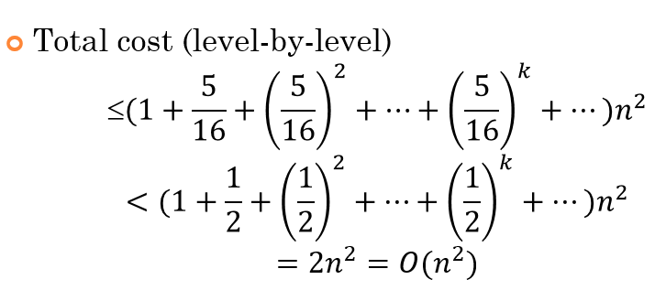

Slide 21
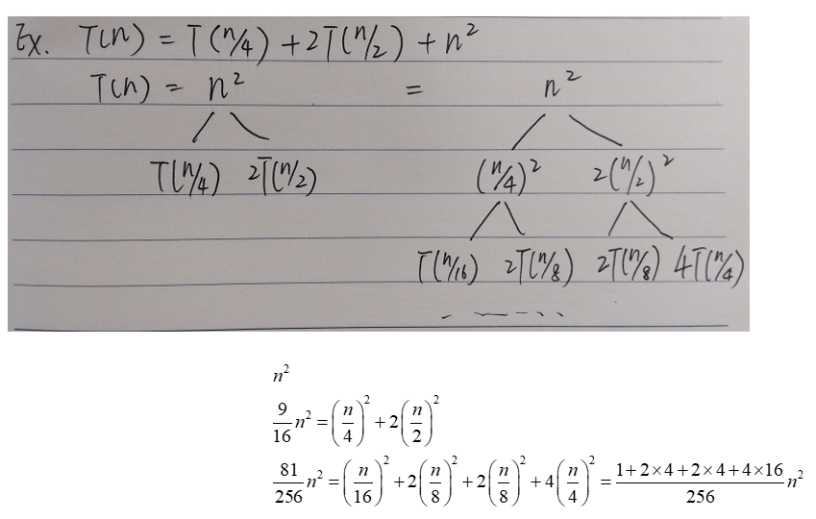

Slide 22
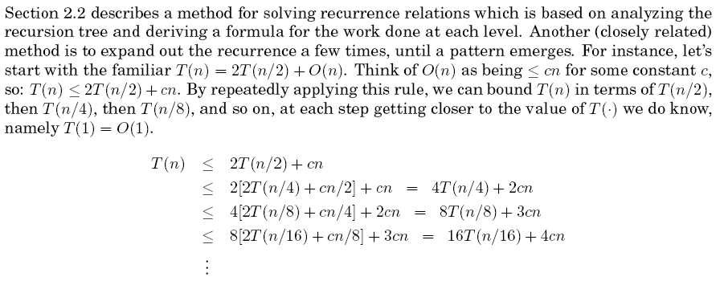
Exercise 1
22

Slide 23
2024/3/4
23

Slide 24
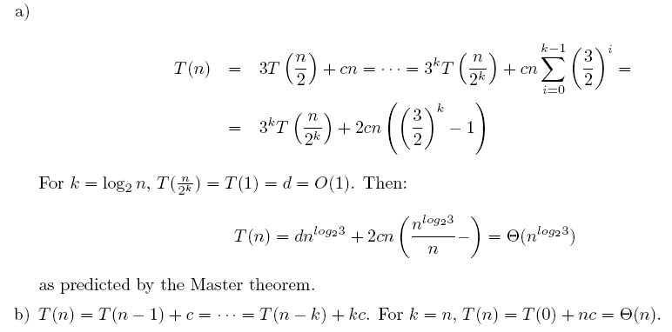
2024/3/4
≤
≤… ≤
≤
≤… ≤

Slide 25
Exercise 2
2024/3/4
25

Slide 26
O(n^{d}log₃n)=O(n²log₃n)
26

Slide 27
Exercise 3
27

Slide 28
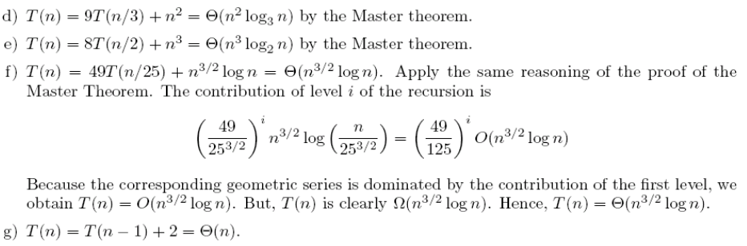
Exercise 3
2024/3/4

Slide 29
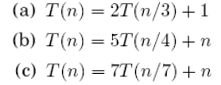
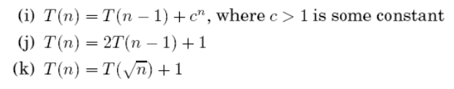
Exercise
Solving the following recurrence relations and give a θ bound for each of them

Slide 30
